Slide 1
Lec.2 Object-Oriented Programming Concepts
Instructor : Prashant Mishra
BIAS Bhimtal

Slide 2
Object-Oriented Programming / Design
This is a programming approach in which data and instructions are group together as an object.
There are many languages in the market which has the policy to disintegrate the data from the procedures and actions which relate to that data. But the specialty of the Object Oriented Programming languages is that it will combine the data and the procedure / action into objects.
So in these languages an object consists of both data and the actions to be performed on that data. Once we program an object, it can be reusable. Today many developers consider object oriented languages in many software developments.

Slide 3
Event Driven Approach / Design
Event driven approach goes hand-in-hands with object orientation. The objects are activated on different events (a key press or click).

Slide 4
What is object-orientation?
Superficially the term object –oriented (OO) means that we organize s/w as a collection of objects that incorporate both data structures and behavior.
This contrasts with previous programming approaches in which data structures and behaviors are loosely connected .
Object oriented approach generally include four aspects: Identity, classification , inheritance and polymorphism.

Slide 5
Identity means that data is quantized into discrete ,distinguishable , entities called objects.
Classification means that object with the same data structure ( attributes )and behavior are grouped into class.
Inheritance is the sharing of attributes and operations (features)among class based on a hierarchical relationship.
Polymorphism means that the same operation may behave differently for different classes.

Slide 6
What is object oriented development?
In this lecture OO development is a way of thinking about s/w based on abstraction that exist in the real world as well as in the program. In this context development refers to the s/w life cycle : analysis ,design and implementation .
The essence of OO development is the identification and organization of application concepts ,rather than their final representation in a programming language.

Slide 7
Modeling concept not implementation
OO development is a conceptual process independent of a programming language until the final stages .
OO development is fundamentally a way of thinking and not a programming technique . It can serve as a medium for specification analysis , documentation , and interfacing as well as programming .

Slide 8
OO methodology
We present a process for OO development and a graphical notation for representing OO concept .
The process consists of building a model of an application and then adding details to it during design .
The methodology has the following stages:

Slide 9
System conception :software development begins with business analyst or users conceiving an application and formulating tentative requirements.
Analysis :The analysis model is a concise , precise abstraction of what the desired system must do ,not how it will be done .The analysis model should not contain implementation decisions .
The analysis model has two parts :
The domain model , a description of the real –world object reflect within the systems;
The application model , a description of the parts of the application systems itself that are visible to the user .

Slide 10
System design :The development team devise a high level strategy – the system architecture – for solving application problem. They also establish policies that will serve as a default for subsequent , more detail portion of design .The system designer must design what decide what performance characteristic to optimize , choose a strategy of attacking the problem , and make tentative resource allocation .

Slide 11
Class design : the class designer adds details to the analysis model in accordance with the system design strategy .
the focus of class design is the data structure and algorithm needed to implement each class.
Implementation :Implementation translate the classes and relationship developed during class design into a particular programming language , database ,or hardware.

Slide 12
Three models
The class model describe the static structure of the object in a system and their relationship .
It contains class diagram . A class diagram is a graph whose nodes are classes and whose arcs are relationship among classes.
A class model defines the context for s/w development.

Slide 13
The State model describe the aspect of an object that change over time .
The State model specifies and implement control with state diagrams .A state diagram is a graph whose nodes are states and whose arcs are transition between states caused by events .
The interaction model describes how the objects in a system cooperate to achieve broader results .

Slide 14
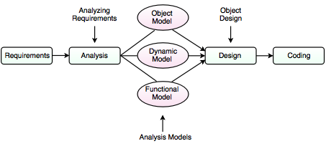

Slide 15
Object oriented themes
Abstraction
Encapsulation
Combining Data and Behavior
Sharing
Emphasis on the essence of an object
synergy

Slide 16
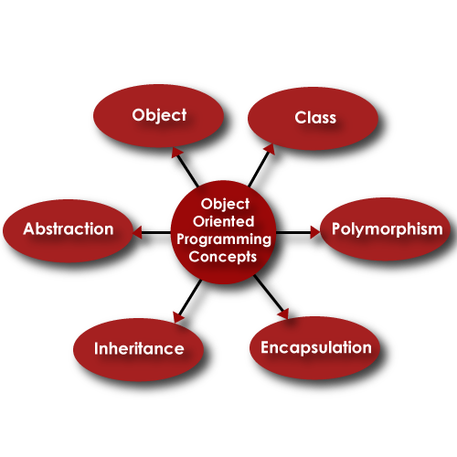

Slide 17
Abstraction
Abstraction is one of the key concepts of object-oriented programming (OOP) languages. Its main goal is to handle complexity by hiding unnecessary details from the user. That enables the user to implement more complex logic on top of the provided abstraction without understanding or even thinking about all the hidden complexity.
It means focusing on the essential aspects of an entity while ignoring its details.
This means focusing on what an object is and does, before deciding how it should be implemented.
Use of abstraction during analysis means dealing only with application domain concepts, not making decisions before problem is understood.

Slide 18
Encapsulation
It means information hiding. It consists of separating the external aspects of an object, which are accessible to other objects, from internal implementation details of the object, which are hidden from other objects.
It prevents program from becoming so interdependent that a small change has massive ripple effect. It gives the ability to combine data structure and behavior in a single entity.

Slide 19
Combining Data and Behavior
The burden of calling code for data execution and operations separately can be minimized by combining data properties and behavioral properties of an entity together.
In object oriented program data structure and procedure is defined in single class definition.

Slide 20
Sharing
Object Oriented technologies promote sharing at different levels. Inheritance of both data structure and behavior lets subclasses share common code.
This sharing via inheritance is one of the main advantages of Object Oriented languages.
Object Oriented Development not only lets you share information within an application but also offers the prospect of reusing designs and code on future projects.

Slide 21
Emphasis on the essence of object:
Object Oriented Technology stresses what an object is, rather than how it is used.
The uses of an object depend on the details of the application and often change during development.

Slide 22
Synergy
Identity, classification, polymorphism and inheritance characterize Object Oriented languages.
Each of these concepts can be used in isolation but together they complement each other synergistically.

Slide 23
Polymorphism
Polymorphism is a concept, which allows us to redefine the way something works, by either changing how it is done or by changing the parts used to get it done. This can be done in two ways, overloading and overriding.

Slide 24
Object-orientation Is a Modeling Technique
We perceive the world as a world of objects. You look around and you see a chair, a table, a person, and the objects are related in one way or another.
The object-oriented technique tries to imitate the way we think, a system developed by using the object-oriented technique can be seen as a system consisting of a number of objects which cooperate to solve a task.

Slide 25
Advantage of OOP
Fast accessing
Less space used
Minimized coding
Secure coding
Object-Oriented system can be easily upgraded from small to large system
Easy to partition the work in a project based on objects.
Software complexity can be easily managed

